Slide 1
Lecture - 1
VEDIC MATHS

Slide 2
Multiplication with powers of 5
Multiplication with series of 1's
Multiplication with series of 9's
Multiplication of 2-digit & 3-digit numbers
Finding squares & square roots
Finding Cube & cube roots

Slide 3
MULTIPLICATION OF NUMBERS WITH 5, 25 & 125
1. 8*5
Solution :- half the number and write one zero with it
So 8*5 = 8/2 =4 and write one zero = 40
2. 8*25
Solution :- half the given number two times and write two zeroes with it
So 8*25 = 8/2 = 4, 4/2 = 2 and write two zeroes= 200
3. 8*125
Solution:- half the given number three times and write three zeroes with it
So 8*125 = 8/2=4,4/2=2,2/2=1 and write three zeroes = 1000

Slide 4
APPLICATIONS
1. Find the product 37 x 25?
A) 935 B) 765 C) 925 D) 245
Find the value of 147*25 ?
A) 3675 B) 3075 C) 3125 D) 3175
Notes:
Difficulty level: Easy
Option-C(Compulsory)
Option-A(optional)

Slide 5
APPLICATIONS
1. Find the product 432 x 125?
A) 35000 B) 54000 C) 33200 D) 52000
Find the value of 3240*125 ?
A) 405000 B) 504000 C) 616000 D) 402000
Notes:
Difficulty level: Easy
Option-C(Compulsory)
Option-A(optional)

Slide 6
MULTIPLICATION OF NUMBERS WITH 11
To multiply any number with 11
Step 1:- Write the last digit as it is
Step 2:- Add last digit to next digit and write the unit digit as it is and carry forward rest and so on
Step 3:- Write the last digit as it is
For example :- 23*11
Step 1:- Keep last digit as 3
Step 2:- Add 3+2 =5
Step 3:- Write last digit as 2
So answer will be 253

Slide 7
APPLICATIONS
Find the value of 79*11?
a)869 b) 789 c) 909 d) 809
2. Find the value of 123*11?
a)1323 b) 1353 c) 1333 d) 1293
Notes:
Difficulty level: Easy
Option-A (Compulsory)
Option- B (Optional)

Slide 8
MULTIPLICATION OF NUMBERS WITH 9, 99 & 999…
To multiply any number with 9,99 & 999…
Step 1:- Write number of zeroes equal to number of 9s on the right hand side of the number to be multiplied
Step 2:- Now subtract the number to be multiplied from this number
For example:- 8*9
Step 1 :- Write one zero with 8 to make the number as 80
Step 2 :- Now subtract 8 from 80 i.e 80-8 = 72
So 8*9 = 72

Slide 9
APPLICATIONS
Find the value of 257*9
a)2353 b) 2303 c) 2313 d) 2363
Find the value of 58*99
a)5632 b) 6182 c) 6822 d) 5742
Notes:
Difficulty level: Easy
Option-C (Compulsory)
Option-D (Compulsory)

Slide 10
APPLICATIONS
3. Find the value of 436*99
a)39452 b) 43164 c) 44724 d) 42492
4. Find the value of 689*999
a)687431 b) 688411 c) 688311 d) 688321
Notes:
Difficulty level: Moderate
3. Option-B (optional))
4. Option-C (Compulsory)

Slide 11
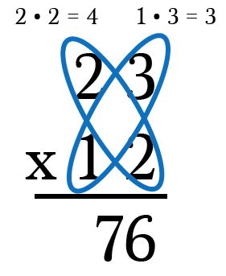
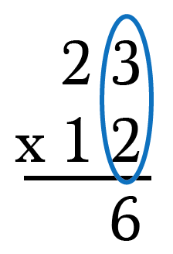
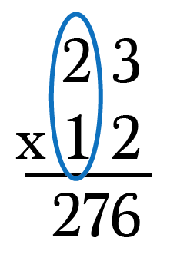
MULTIPLICATION OF TWO DIGIT NUMBERS USING CRISS CROSS METHOD

Slide 12
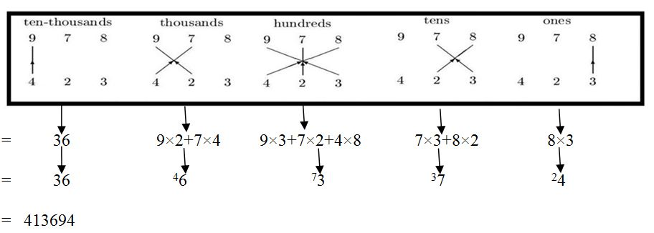
MULTIPLICATION OF THREE DIGIT NUMBERS (CRISS CROSS METHOD)
Multiplication of three digit numbers are explained in the given steps

Slide 13
APPLICATIONS
Find the value of 86*47
a) 4042 b) 4112 c) 4052 d) 4132
2. Find the value of 42*48
a) 2026 b) 2096 c) 2016 d) 2116
Notes:
Difficulty level: easy
Option-A(Compulsory)
Option-C(Compulsory)

Slide 14
APPLICATIONS
3. Find the value of 247*324
a)80228 b) 80178 c) 80128 d) 80028
4. Find the value of 786*549
a)431574 b) 431514 c) 431534 d) 431554
Notes:
Difficulty level: Moderate
3. Option-D (Compulsory)
4. Option-B (Optional)

Slide 15
SQUARE
For Squares of 2-digit numbers
Select any number from 11-99 :- (44)^2
Step 1:- take it as (40+4)^2 = 40^2 +4^2 +2*40*4
Step 2:- (44)^2 = 1600+16+320 = 1936
OR
Using Base value
Take base as 40.
So, square will be = (44+4)*40 +4² = 1920+16 = 1936

Slide 16
Base Method
MF (Number +/- Deviation)/ (Deviation)^2
MF = Multiplicative factor Deviation = Difference from the base
*According to the base, the multiplicative factor will be changed. For base 100 MF =1 For base 200 MF = 2 For base 150 MF = 1.5 and so on…….

Slide 17
Base-100
Example 1: Find square of 102 in seconds?
Step 1:Take 100 as base and see how far the number is from 100. Add the given number and its deviation. Lets say you need to square 102.Here you can notice that the number is 2 more than 100. Adding the given number(102) and its deviation(2) we get, 102+2=104
Step 2:Square the deviation(2)and place it next to the result obtained in step 1. Squaring we get, 22=4
Ans 10404

Slide 18
Base - 100
106^2 = ?
(106 + 6) / 6^2 = 11236
91^2 =? (91 - 9)/ 9^2 = 8281
112^2 = ?
(112 + 12) / 12^2 = 124/144 = 12544

Slide 19
SQUARE
For Squares of three digit numbers
Using base value
As 588=600-12, so take the base value as 600.
So, square of the number will be= (588-12)*600 +12² = 345600+144 = 345744

Slide 20
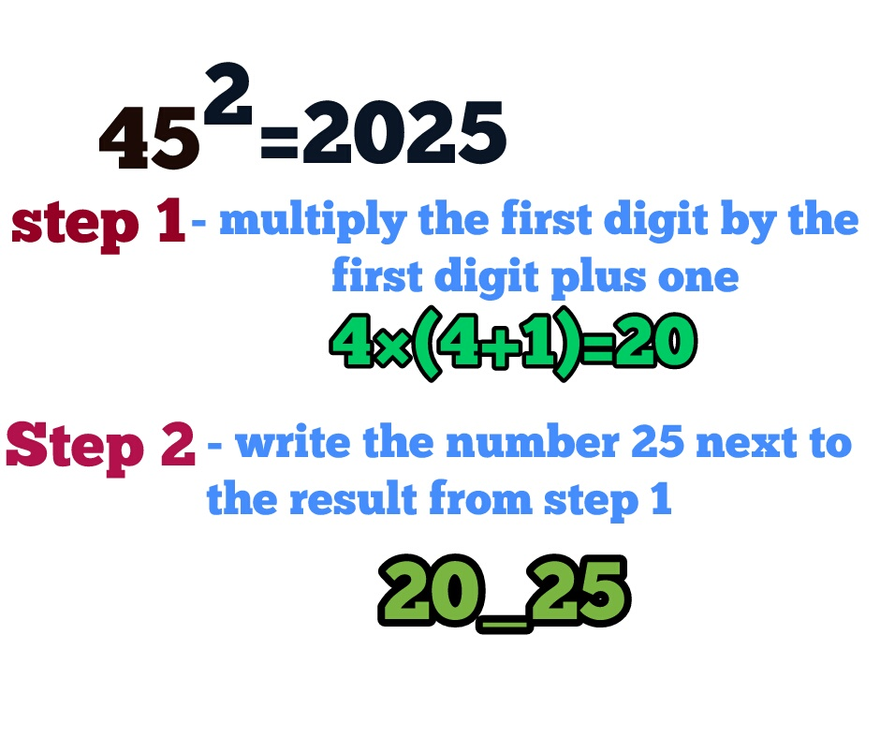
SQUARE OF NUMBERS ENDING WITH 5

Slide 21
APPLICATIONS
Find the square of 46?
a) 2116 b) 2378 c) 2216 d) 2316
2. Find the square of 396?
a) 156216 b) 156816 c) 152664 d) 161664
3. Find the square of 112?
a) 11544 b) 12544 c) 11344 d) 12444
Notes:
Difficulty level: Moderate
Option-A (Compulsory)
Option –B (Compulsory)
Optio – B (optional)

Slide 22
SQUARE ROOT SHORTCUTS (For Perfect Square Numbers Only)
Step 1: Check unit digit of the no. (in pair).
Step 2: Select whose square less than remaining no.
Step 3: Multiply no. with consecutively next no.
Step 4: Compare & select
Number | Square | Last digit
1 | 1 | 1
2 | 4 | 4
3 | 9 | 9
4 | 16 | 6
5 | 25 | 5
6 | 36 | 6
7 | 49 | 9
8 | 64 | 4
9 | 81 | 1
Example:12544
2 or 8
11²<125<12²
Now, 11*12 = 132
125<132; So, we’ll choose the smaller number i.e. 11.
Answer will be 112

Slide 23
APPLICATIONS
Find the square root of 14641
a) 121 b) 91 c) 111 d) 141
2. Find the square root of 233289
a) 587 b) 377 c)483 d) 733
Notes:
Difficulty level: Moderate
Option-A (Compulsory)
Option-C (optional)

Slide 24
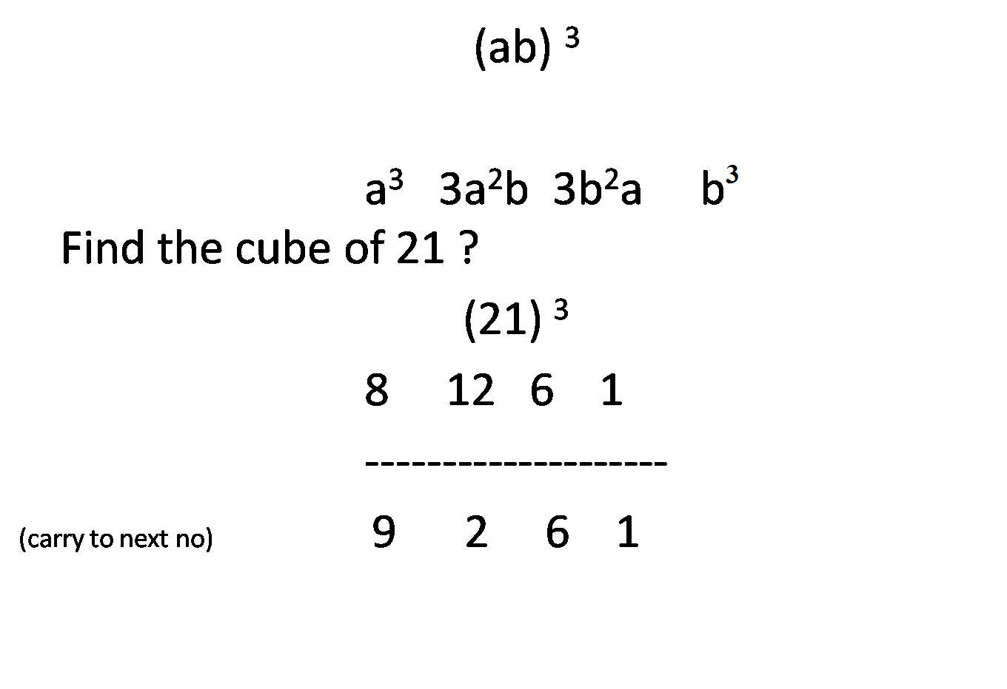
HOW TO FIND CUBE

Slide 25
APPLICATIONS
1. Find the Cube of 17
4179 b) 4963 c) 3821 d) 4913
2. Find the Cube of 24
a) 14178 b) 14964 c) 13824 d) 13148
3. Find the Cube of 73
a) 384131 b) 389017 c) 413141 d) 361487
Notes:
Difficulty level: moderate
1. Option – D (Compulsory)
2. Option-C (Compulsory)
3. Option-B (optional)

Slide 26
CUBE ROOT SHORTCUTS
Step 1: Check unit digit and write its corresponding last digit number
Step 2: Ignore the last three digits
Step 3:Select whose cube is less than or equal to the remaining digit.
Step 4: Write that number with the corresponding number
Number | Cube | Last digit
1 | 1 | 1
2 | 8 | 8
3 | 27 | 7
4 | 64 | 4
5 | 125 | 5
6 | 216 | 6
7 | 343 | 3
8 | 512 | 2
9 | 729 | 9
Example:110592
8
4³
Now, 48 will be the answer

Slide 27
APPLICATIONS
Find the cube root of 5832
a) 14 b) 18 c) 16 d) 22
2. Find the cube root of 24389
a) 33 b) 43 c) 23 d) 29
Notes:
Difficulty level: easy
Option- B (optional)
Option- D (compulsory)

